Slide 1
The Black Isle Litter Survey 2021
Monday, April 05, 2021

Slide 2
378
Total Responses
Date Created: Sunday, February 21, 2021
Complete Responses: 158

Slide 3
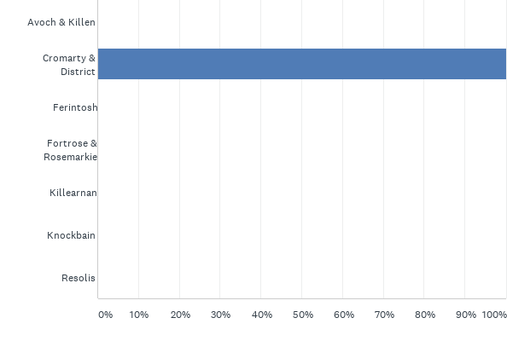
Q1: In which community council area do you live?
Answered: 32 Skipped: 0

Slide 4
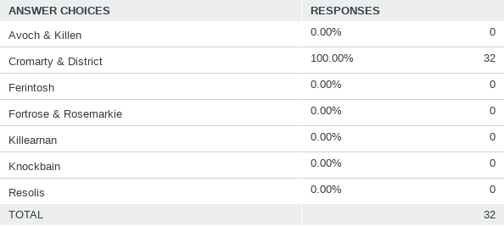
Q1: In which community council area do you live?
Answered: 32 Skipped: 0

Slide 5
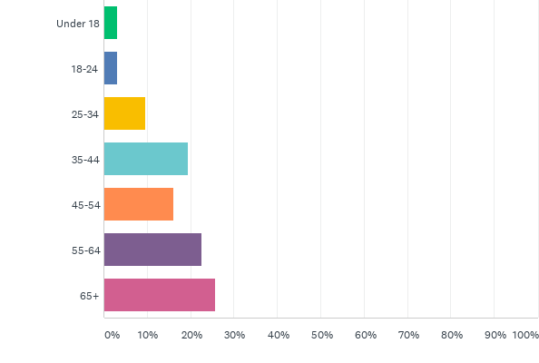
Q2: What is your age?
Answered: 31 Skipped: 1

Slide 6
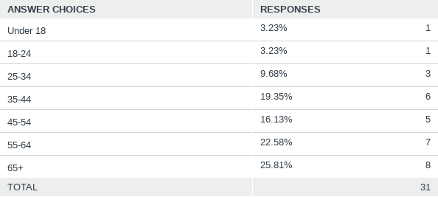
Q2: What is your age?
Answered: 31 Skipped: 1

Slide 7
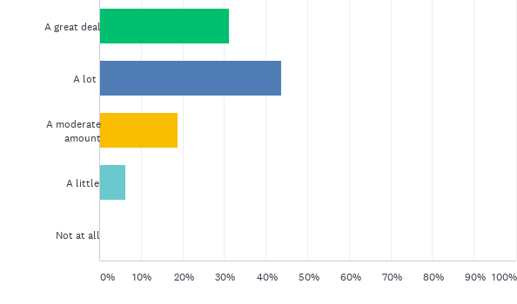
Q3: How concerned are you with the amount of litter in your local community?
Answered: 32 Skipped: 0

Slide 8
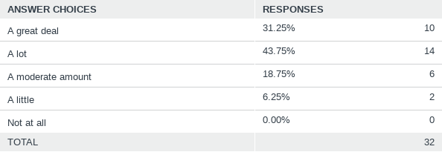
Q3: How concerned are you with the amount of litter in your local community?
Answered: 32 Skipped: 0

Slide 9
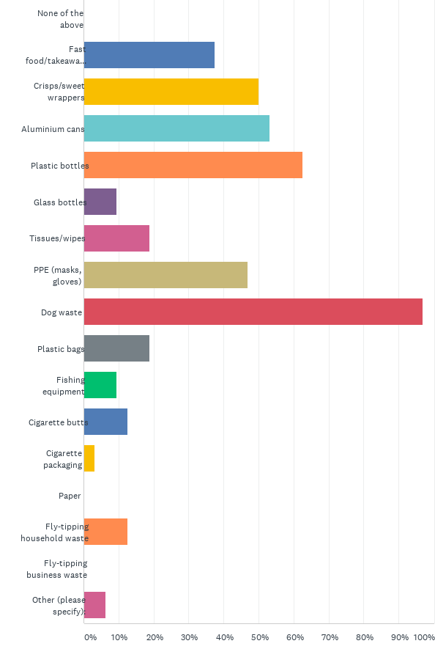
Q4: Is there a specific type of litter that commonly appears in your community? (please tick all that apply)
Answered: 32 Skipped: 0

Slide 10
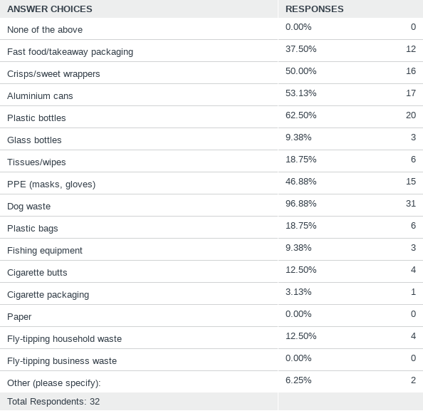
Q4: Is there a specific type of litter that commonly appears in your community? (please tick all that apply)
Answered: 32 Skipped: 0

Slide 11
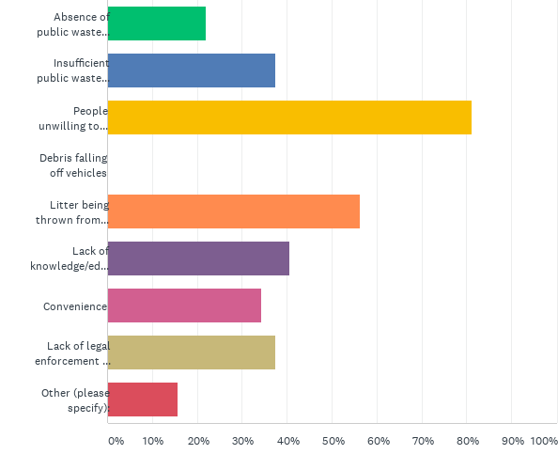
Q5: What factors do you think contribute most to litter in your area? (please tick all that apply)
Answered: 32 Skipped: 0

Slide 12
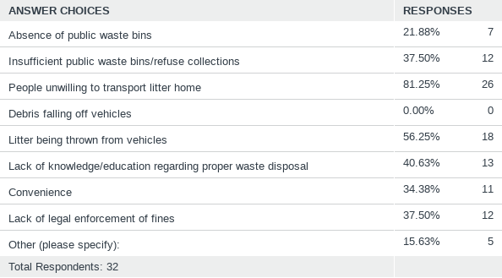
Q5: What factors do you think contribute most to litter in your area? (please tick all that apply)
Answered: 32 Skipped: 0

Slide 13
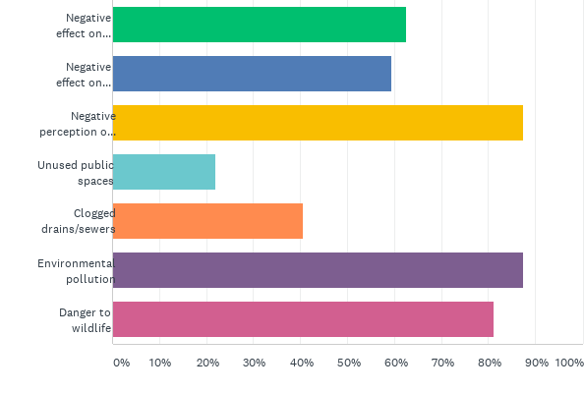
Q6: What consequences do you associate with large amounts of litter? (please tick all that apply)
Answered: 32 Skipped: 0

Slide 14
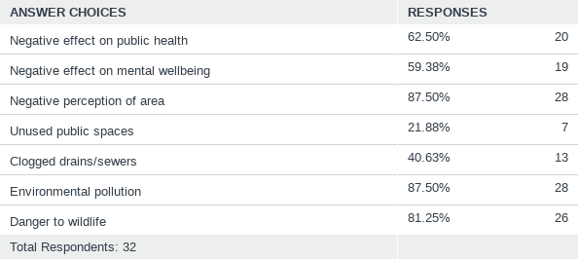
Q6: What consequences do you associate with large amounts of litter? (please tick all that apply)
Answered: 32 Skipped: 0

Slide 15
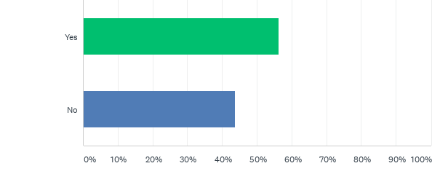
Q7: We already have several volunteers doing year-round picks at popular locations such as Chanonry Point, the adjacent beaches, and the walking routes around Avoch. Is there an area in your local community that would benefit from a one-off volunteer group litter pick (once COVID restrictions are eased) or regular volunteer litter picking?
Answered: 32 Skipped: 0

Slide 16
Q7: We already have several volunteers doing year-round picks at popular locations such as Chanonry Point, the adjacent beaches, and the walking routes around Avoch. Is there an area in your local community that would benefit from a one-off volunteer group litter pick (once COVID restrictions are eased) or regular volunteer litter picking?
Answered: 32 Skipped: 0

Slide 17
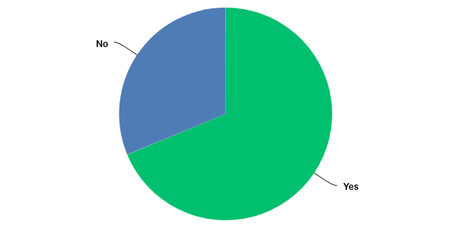
Q8: Do you think the Black Isle would benefit from more recycling facilities?
Answered: 32 Skipped: 0

Slide 18
Q8: Do you think the Black Isle would benefit from more recycling facilities?
Answered: 32 Skipped: 0

Slide 19
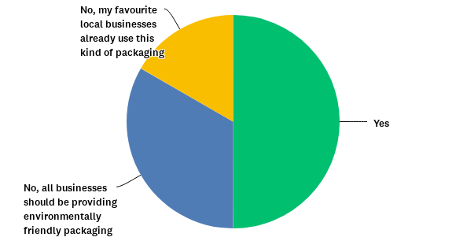
Q9: Would you be happy to pay a little extra for takeaway food and drinks, to support the use of environmentally friendly packaging?
Answered: 30 Skipped: 2

Slide 20
Q9: Would you be happy to pay a little extra for takeaway food and drinks, to support the use of environmentally friendly packaging?
Answered: 30 Skipped: 2

